Slide 1
Attitude Controller
Waypoint
LOS guidance
Φ_des
e_cross
Mx
Flying taxi
PID
PID
u
v
X_req
φ
w
e_along
ϴ_des
My
p
Y_req
PID
PID
q
ϴ
r
Ѱ_des
Mz
φ
PID
ϴ
Ѱ
Ѱ
X
Y
Altitude Controller
X
Y
Z_req
ΔT_allmotors
Z
PID
Z

Slide 2
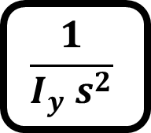
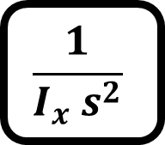

G_phi
Mx
$$\frac{1}{I_{x} s^{2}}$$
Φ_des
PID
φ
φ
G_th
My
$$\frac{1}{I_{y} s^{2}}$$
ϴ_des
PID
ϴ
ϴ
G_psi
Mz
$$\frac{1}{I_{z} s^{2}}$$
Ѱ_des
PID
Ѱ
Ѱ

Slide 3
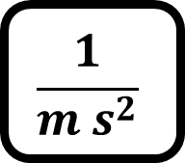
G_Z
ΔT_allmotors
$$\frac{1}{m s^{2}}$$
Z_des
PID
Z
Z

Slide 4

K
e_alongtrack
R
S
e_crosstrack
K-1
$$α_{k}$$
Current position
Y
X

Slide 5
LOS guidance
e_cross
PID
Φ_des
X_req
e_along
PID
Y_req
ϴ_des
Ѱ_des
X
Y

